Slide 1
Algorithms – I (CS29003/203)
Autumn 2022, IIT Kharagpur
Graphs

Slide 2
Resources
Apart from the book
UC Davis ECS 36C Course by Prof. Joël Porquet-Lupine
UC Riverside, CS 141 course, Fall 2021 by Prof. Yan Gu and Prof. Yihan Sun

Slide 3

Introduction - Seven Bridges of Königsberg
Context
Paper published by Leonhard Euler in 1736
Regarded as first in history of graph theory
Problem
City of Königsberg in old Prussia
Split in four pieces: 2 mainland portions and 2 islands
Interconnected by 7 bridges
Problem: is it possible to walk through the city, crossing each bridge once and only once?
Euler proved that the problem had no solution
Developed new technique of analysis to support his proof
Know Euler - Very interesting talk (must see if you ask me) - Link
Source: UC Davis, ECS 36C course, Spring 2020
Image is taken from wikipedia

Slide 4
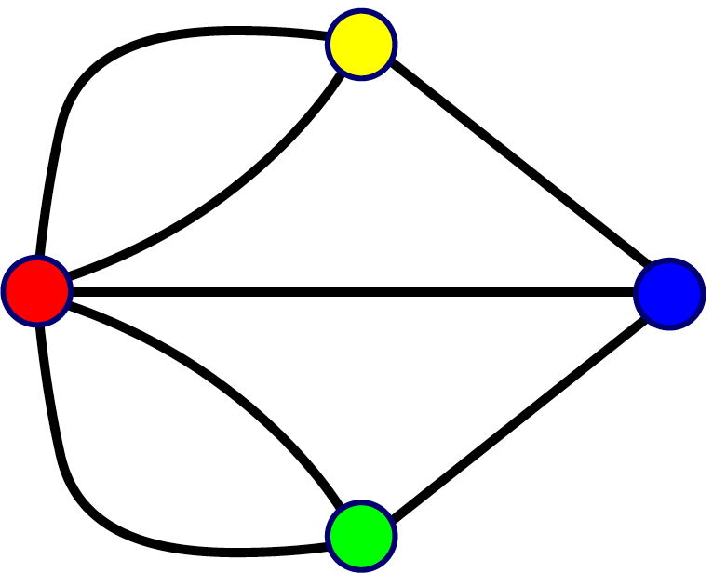
Introduction - Seven Bridges of Königsberg
Representation
Reformulated the problem in abstract termsRegarded as first in history of
Land mass: vertex (or node)
Bridge: edge
Resulting representation is a graph
Analysis
Need graph to be connected
Possibility of a walk depends on the degrees of the nodes
Source: UC Davis, ECS 36C course, Spring 2020

Slide 5
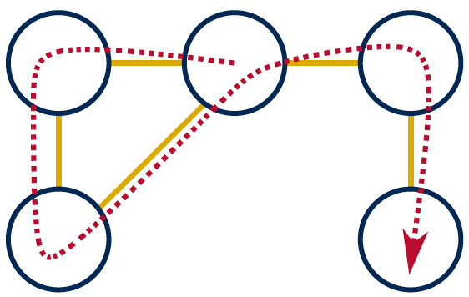
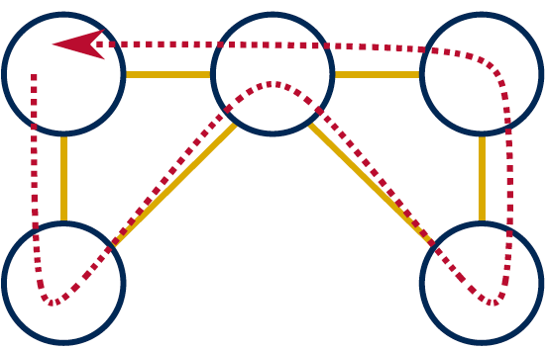
Introduction - Seven Bridges of Königsberg
Euler’s proposals
Eulerian path
Aka Euler walk
Path traversing all edges exactly once
Only possible if graph has exactly zero or two nodes of odd degree
If two nodes of odd degree: start path at one and end at the other
Eulerian circuit
Aka Euler tour
Path traversing all edges with same start and end point
Only possible if all nodes are of even degree
Source: UC Davis, ECS 36C course, Spring 2020

Slide 6
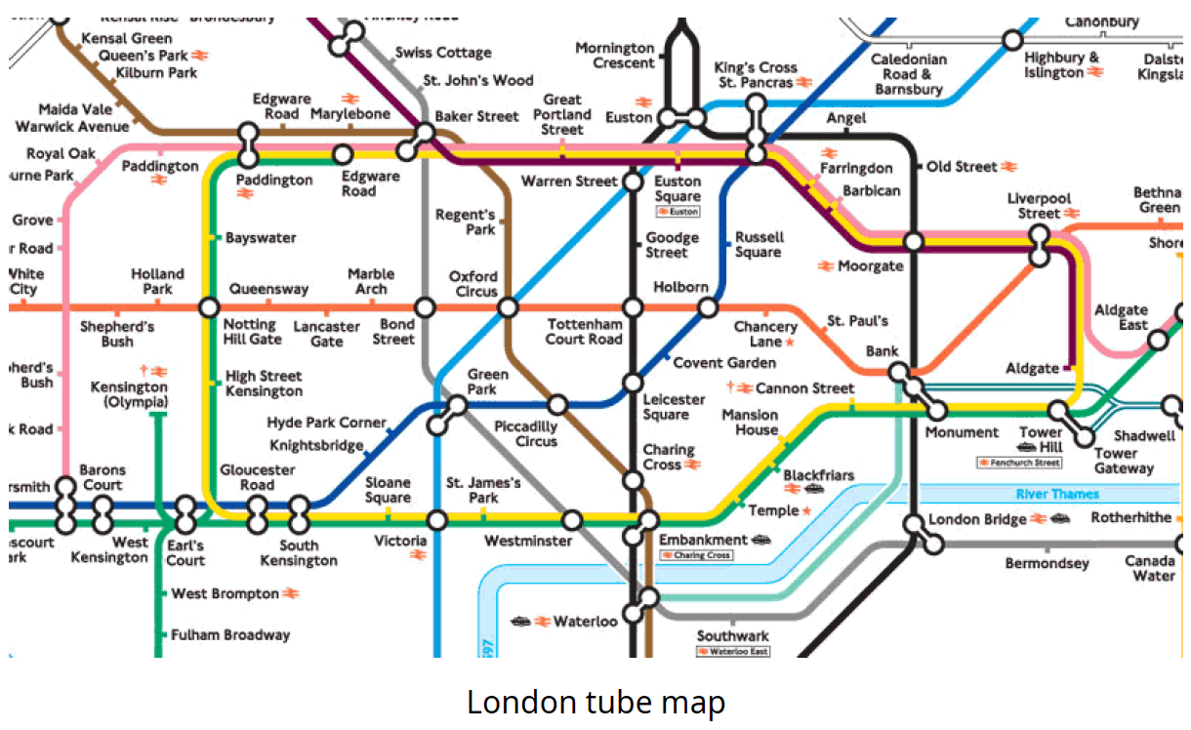
Introduction - Graphs
Set of vertices connected pairwise by edges
Extremely versatile, apply to thousands of practical applications
Many known algorithms to manipulate graphs
Examples - Subway map
Source: UC Davis, ECS 36C course, Spring 2020

Slide 7
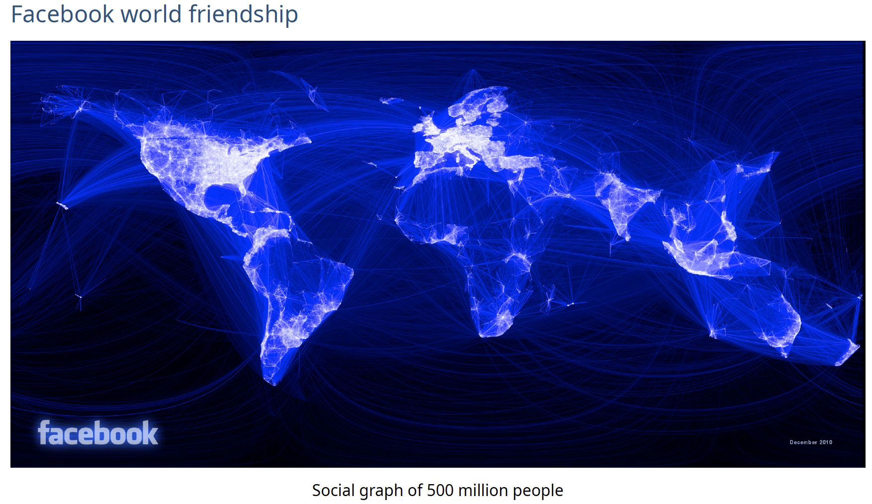
Introduction - Graphs
Examples – Facebook World Friendship Map
Source: UC Davis, ECS 36C course, Spring 2020

Slide 8
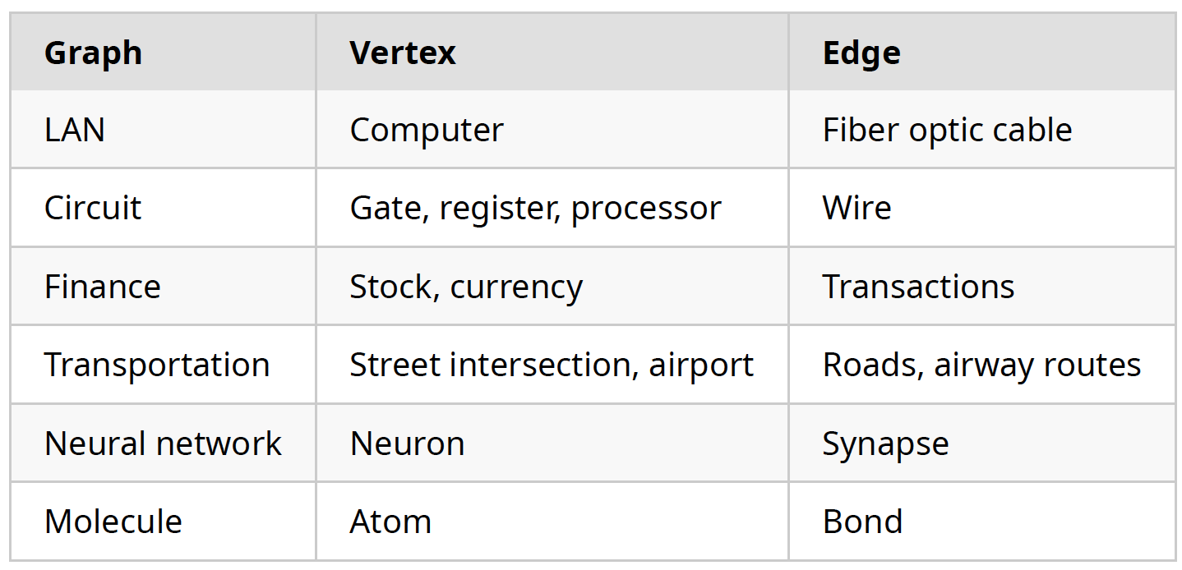
Introduction - Graphs
Other application examples
Source: UC Davis, ECS 36C course, Spring 2020

Slide 9
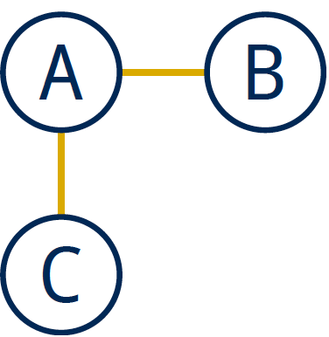
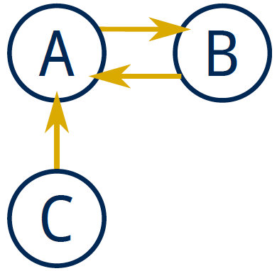
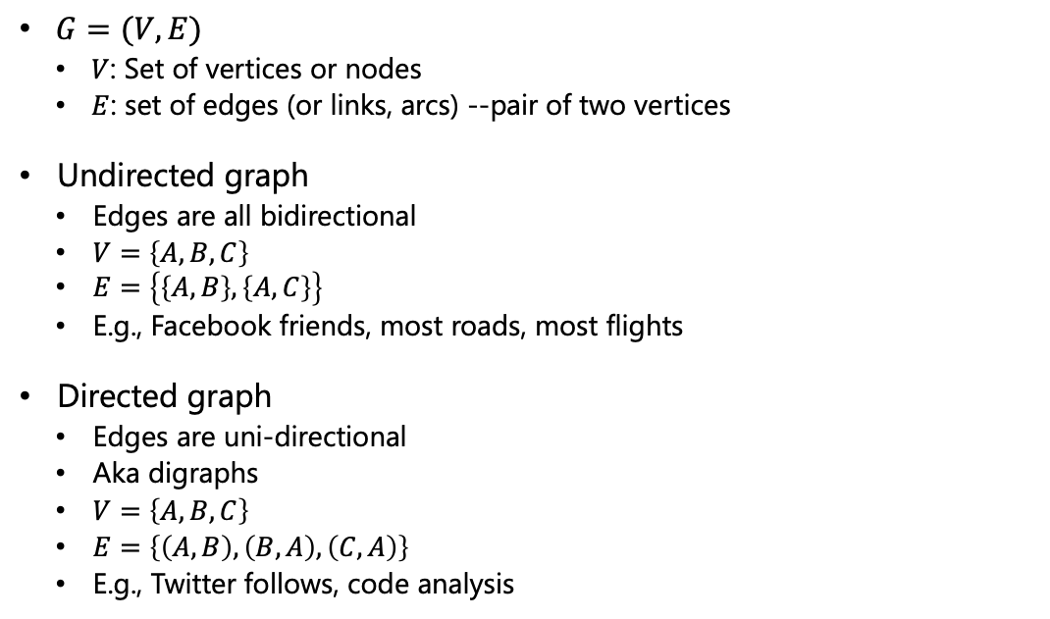
Graphs - Definitions
$G=(V, E)$
$V$: Set of vertices or nodes
$E$: set of edges (or links, arcs) --pair of two vertices
Undirected graph
Edges are all bidirectional
$V=\left\{A, B, C\right\}$
$E=\left\{\left\{A, B\right\}, \left\{A, C\right\}\right\}$
E.g., Facebook friends, most roads, most flights
Directed graph
Edges are uni-directional
Aka digraphs
$V=\left\{A, B, C\right\}$
$E=\left\{\left(A, B\right), \left(B, A\right), \left(C, A\right)\right\}$
E.g., Twitter follows, code analysis
Source: UC Davis, ECS 36C course, Spring 2020

Slide 10
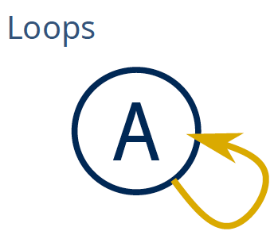
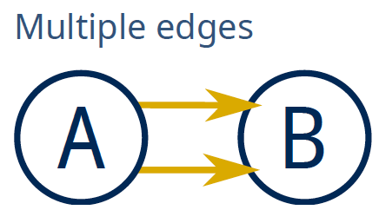
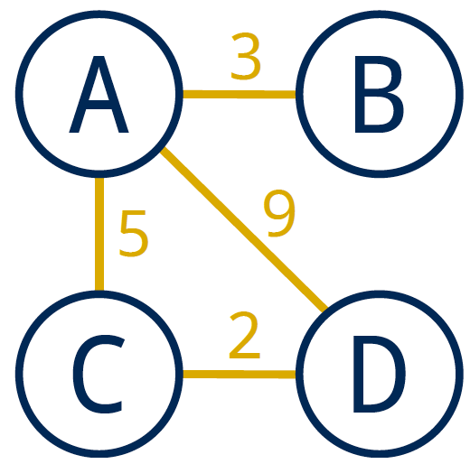
Graphs - Definitions
Multigraph
A multigraph is a graph (directed or not) in which multiple edges and loops are allowed
Simple graph
A simple graph is an undirected graph which has neither multiple edges nor loops
Default definition of a graph
Weighted graph
In a weighted graph, each edge is associated with a weight
Weights usually represent costs, lengths, capacities, etc.
Depends on the problem at hand
Source: UC Davis, ECS 36C course, Spring 2020

Slide 11
Graphs - Definitions
Degree of a vertex
Number of edges incident on vertex
Only relevant for digraphs:
In-degree: number of edges incident to vertex
Out-degree: number of edges incident from vertex
0-degree vertices
All these graphs are valid
A
B
C
A
B
A
B
A
B
C
C
C
C: in-degree of 0
B: out-degree of 0
C: degree of 0
Source: UC Davis, ECS 36C course, Spring 2020

Slide 12
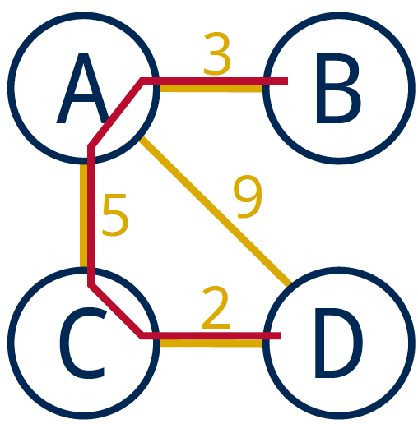
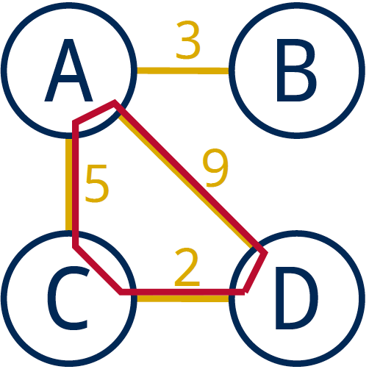
Graphs - Definitions
Path
Sequence of vertices connected by edges
Length: number of edges along the path
Weight: sum of all edge weights along the path
Cycle
Path whose first and last vertices are the same
A graph containing no cycles is said to be acyclic
Source: UC Davis, ECS 36C course, Spring 2020

Slide 13
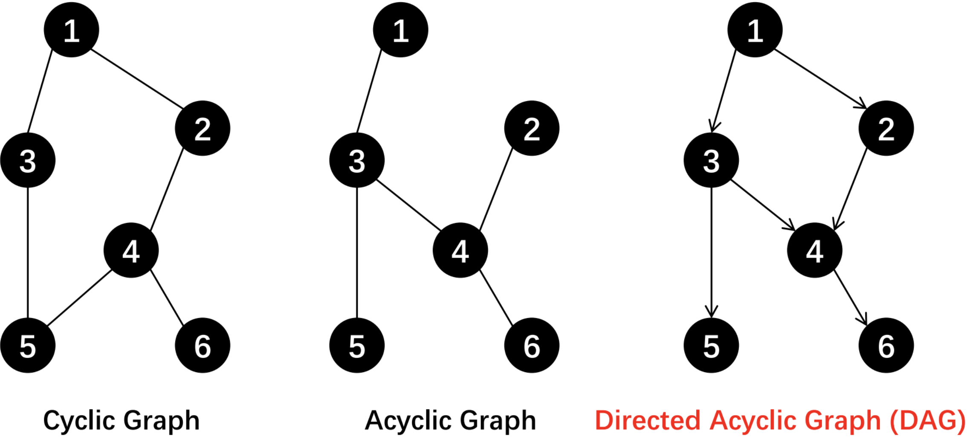
Graphs - Definitions
Source: UC Riverside, CS141 course, Fall 2021

Slide 14
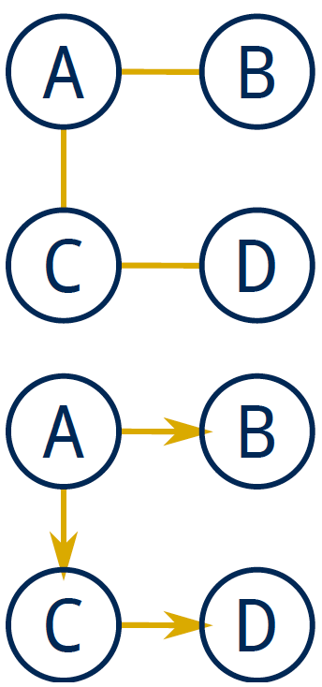
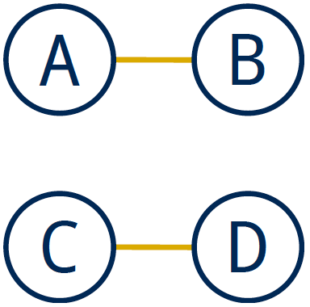
Graphs - Definitions
Connected graph
Vertices are connected if there is a path between them
For directed graphs
Strongly connected if directed path between two vertices
Weakly connected otherwise
A connected graph is a graph in which every pair of vertices are connected
If every pair of vertices is joined by an edge, the graph is complete or fully-connected
Disconnected graph
A disconnected graph is composed of two or more connected components
Source: UC Davis, ECS 36C course, Spring 2020

Slide 15
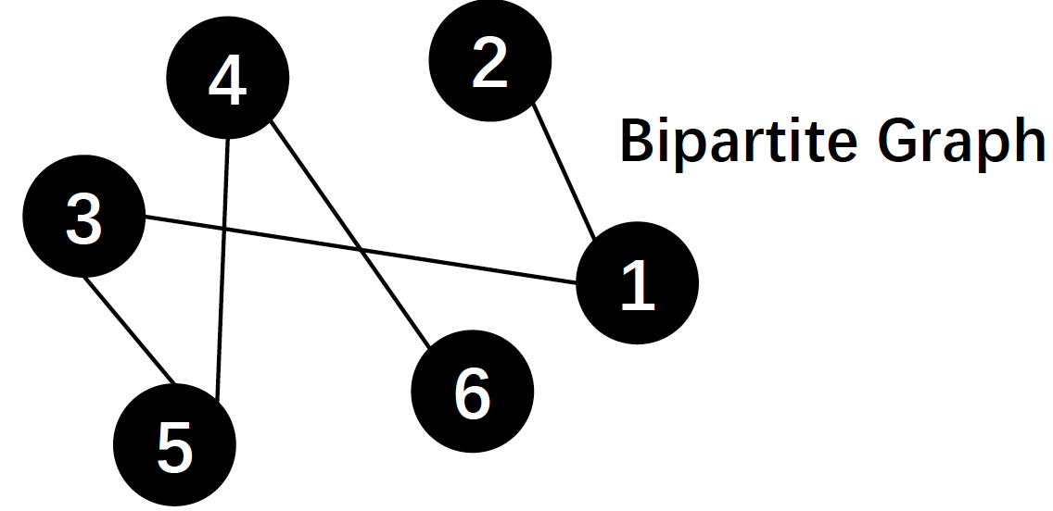
Graphs - Definitions
Bipartite graph
A graph where the vertices can be partitioned into two subsets:
no edges within a subset and all the edges are between two subsets
Usually, vertices in two subsets have different meanings
E.g., students and courses, courses and classrooms, jobs and applicants
Source: UC Riverside, CS141 course, Fall 2021

Slide 16
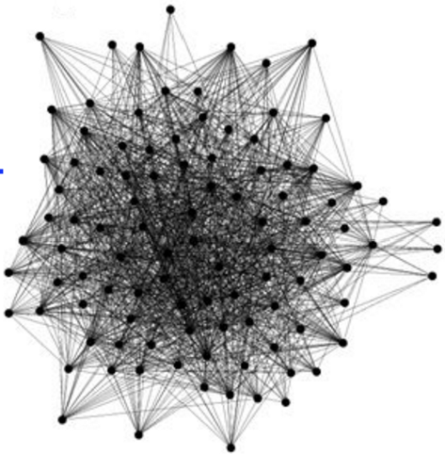
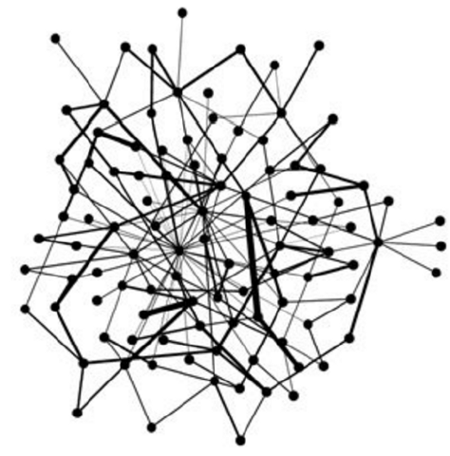
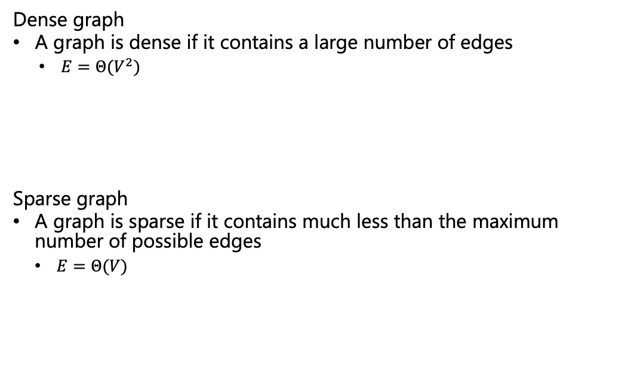
Graphs - Definitions
Dense graph
A graph is dense if it contains a large number of edges
$E=Θ(V^{2})$
Sparse graph
A graph is sparse if it contains much less than the maximum number of possible edges
$E=Θ(V)$
Source: UC Davis, ECS 36C course, Spring 2020

Slide 17
Trees
Trees are a specific kind of graph too!
Undirected, acyclic, connected, rooted graph
A forest is a graph in which multiple connected components are trees
A
B
C
D
E
F
G
H
I
J
K
Source: UC Davis, ECS 36C course, Spring 2020

Slide 18
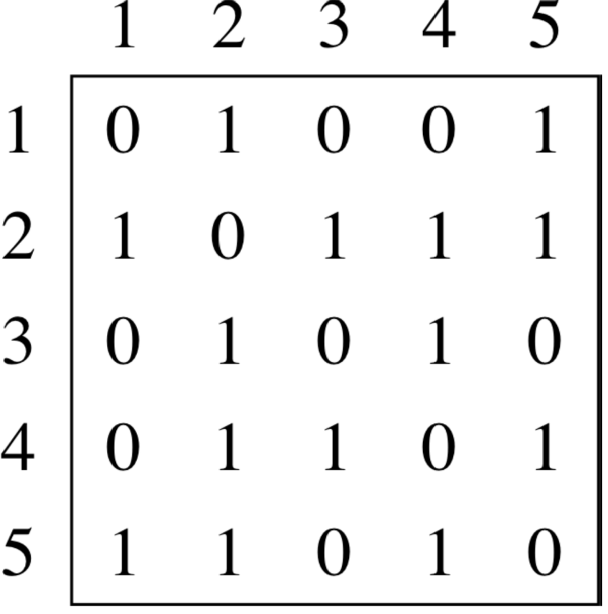
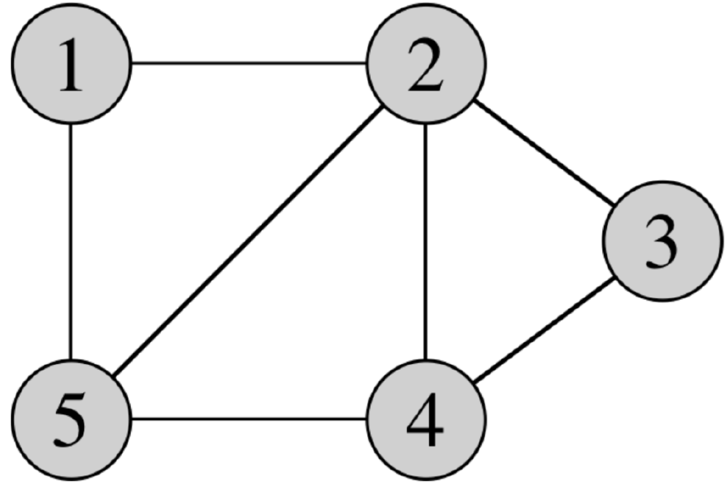
Graph Representations
Adjacency matrix
Source: UC Riverside, CS141 course, Fall 2021

Slide 19
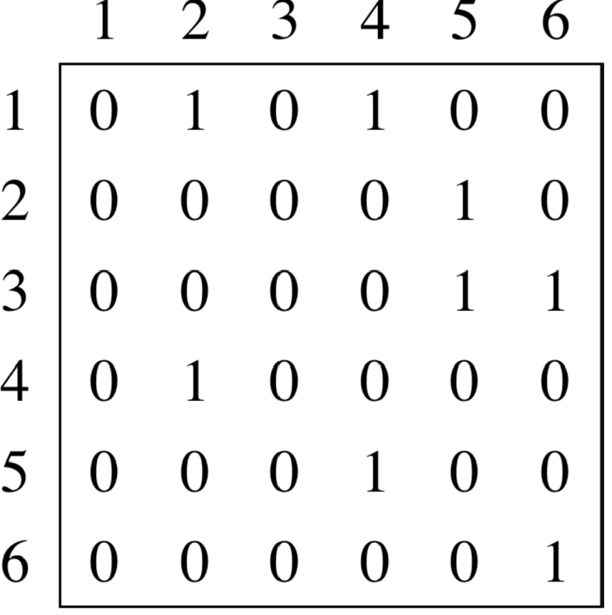
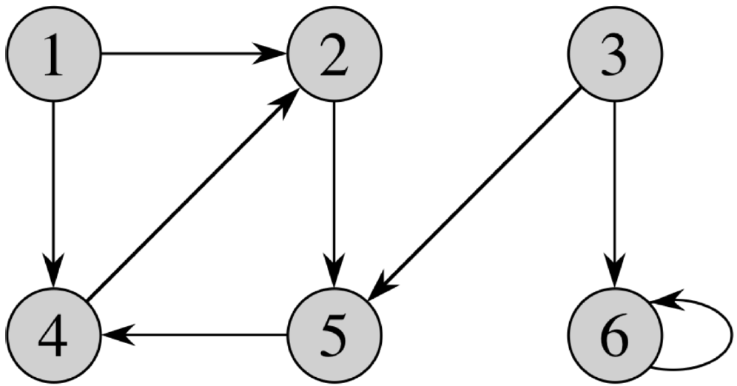
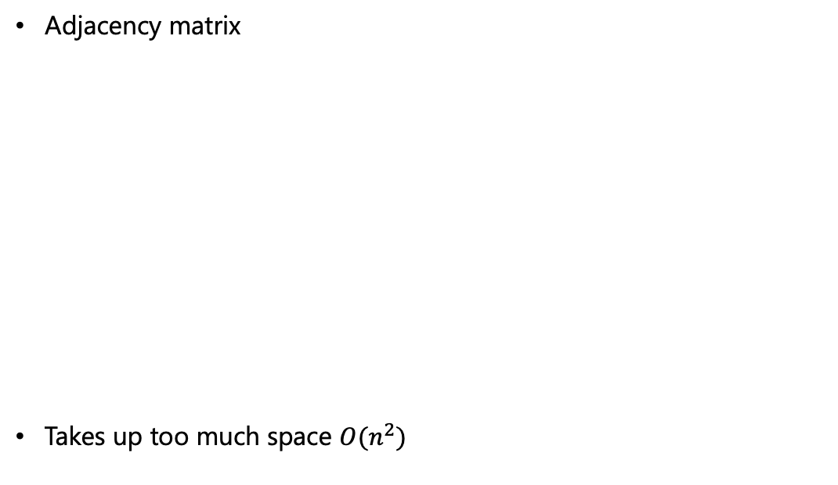
Graph Representations
Adjacency matrix
Takes up too much space $O(n^{2})$
Source: UC Riverside, CS141 course, Fall 2021

Slide 20
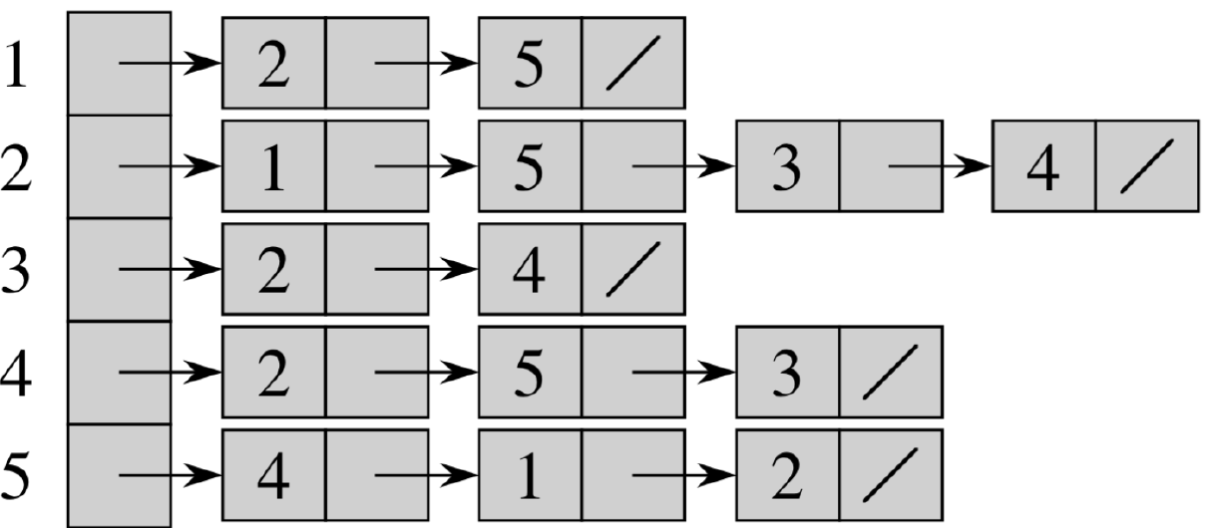
Graph Representations
Adjacency list
Source: UC Riverside, CS141 course, Fall 2021

Slide 21
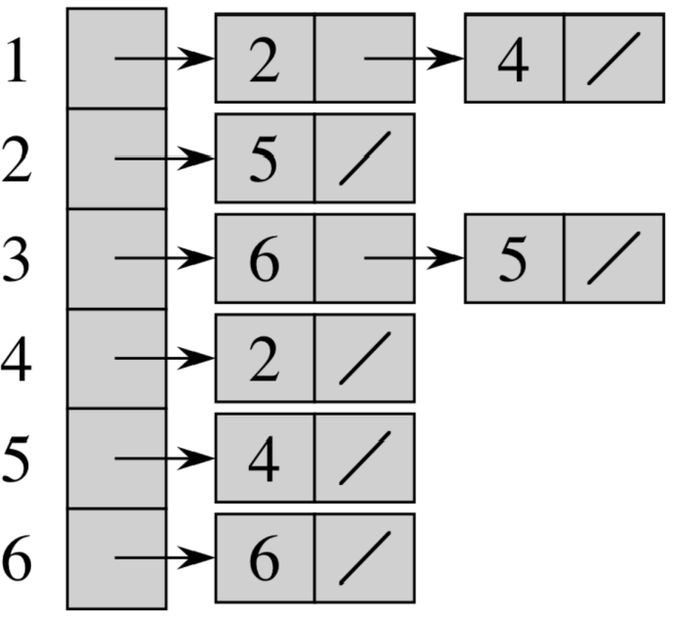
Graph Representations
Adjacency matrix
What do scientists use in practice?
Source: UC Riverside, CS141 course, Fall 2021

Slide 22
Thank You

